Slide 1


Hospital Patient Management System
Welcome to our presentation on the Hospital Patient Management System. This system streamlines patient data handling, provides an intuitive interface, and ensures seamless operations for healthcare providers.
by Mona Raj

Slide 2

Problem Statement
1
Manage Patient Records
2
Improve Data Handling
Implement CRUD (Create, Read, Update, Delete) operations to efficiently handle patient data.
Simplify the process of storing, accessing, and updating patient information.

Slide 3
System Objectives
Intuitive Interface
Seamless Operations
Provide a user-friendly and easy-to-navigate interface for healthcare professionals.
Ensure a smooth and efficient workflow for patient data management.

Slide 4

System Requirements
C-based CLI
Menu-driven Algorithm
Develop a command-line interface (CLI) application using the C programming language.
Implement a menu-driven algorithm to guide users through the system's functionalities.

Slide 5
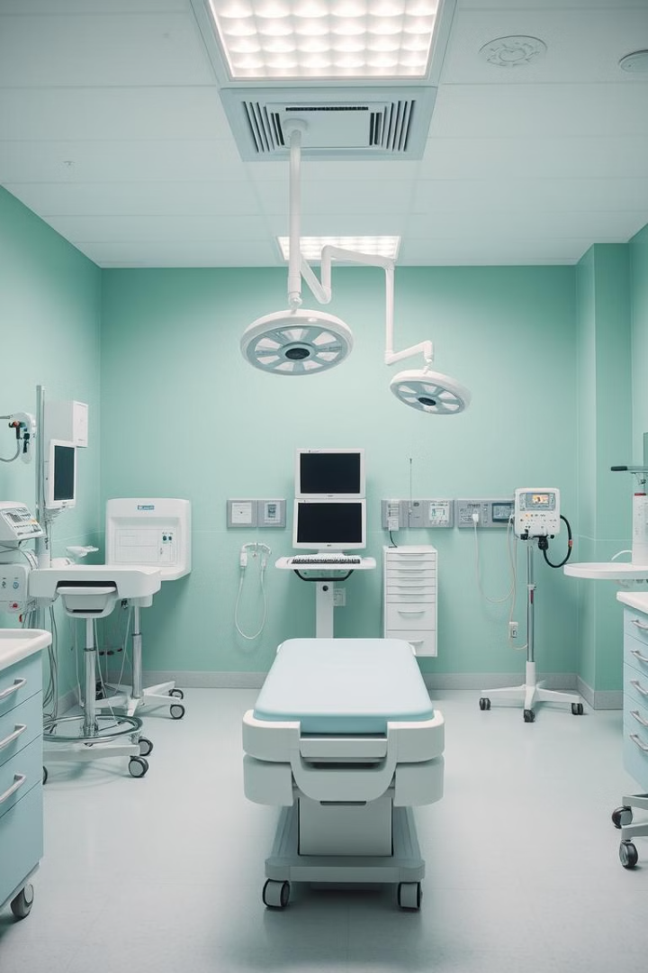



Constraints
Predefined Data
The system will work with a predefined set of data for 4 patients.
Fixed Fields
The system will have a fixed set of data fields for each patient.
Validated Inputs
The system will validate user inputs to ensure data integrity.

Slide 6

Benefits
User-friendly
Reduced Errors
The intuitive interface simplifies patient data management for healthcare professionals.
Validated inputs and organized data storage minimize the risk of errors.

Slide 7
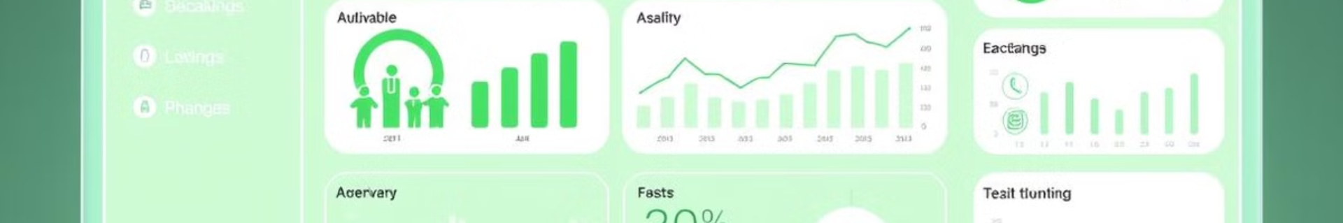
Future Scope
Database Integration
Advanced Search
Integrate a database to store and manage patient records more efficiently.
Implement advanced search functionality to quickly retrieve specific patient information.
1
2
3
Graphical User Interface
Develop a GUI (Graphical User Interface) for a more visually appealing and intuitive user experience.

Slide 8

Conclusion
The Hospital Patient Management System aims to streamline patient data handling, provide an intuitive interface, and ensure seamless operations for healthcare professionals. By addressing the problem statement, meeting the system objectives, and considering the constraints, this system offers numerous benefits and has a promising future scope for further enhancements.

